Slide 1
Objectives
In this session, you will learn to:
  Create and manage indexes

Slide 2
Creating and Managing Indexes
Flash presentation: Implementing Indexes
SQL Server 2005 allows you to create several indexes on a table, which helps in accessing data in the least possible time.
Notes:
CG Input: While teaching the students how to store and retrieve XML data, you need to demonstrate the examples given in the chapter. For the demonstration, you can use the data files present in the TIRM CD to create the required database objects or files.
Before showing the example, execute the CreateTable.SQL database script , present in the Chapter 5\Instep folder of the TIRM CD. Use CustomerDetails.xml for the XML snippet.

Slide 3
Identifying the Types of Indexes
Index:
  Enables fast searching of data.
  Accelerates queries that join tables, and performs sorting and grouping.
  Enforces uniqueness of rows, (if configured for that)
  Contains a collection of keys and pointers.
  Keys are the values built from one or more columns in the table.
Notes:
CG Input: While teaching the students how to store and retrieve XML data, you need to demonstrate the examples given in the chapter. For the demonstration, you can use the data files present in the TIRM CD to create the required database objects or files.
Before showing the example, execute the CreateTable.SQL database script , present in the Chapter 5\Instep folder of the TIRM CD. Use CustomerDetails.xml for the XML snippet.

Slide 4
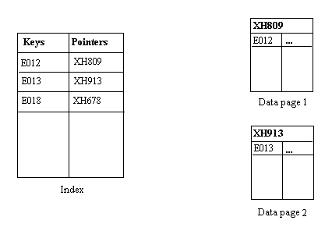
Identifying the Types of Indexes (Contd.)
Pointers store the address of the location where a data page is stored in the memory, as depicted in the following figure.
Notes:
CG Input: While teaching the students how to store and retrieve XML data, you need to demonstrate the examples given in the chapter. For the demonstration, you can use the data files present in the TIRM CD to create the required database objects or files.
Before showing the example, execute the CreateTable.SQL database script , present in the Chapter 5\Instep folder of the TIRM CD. Use CustomerDetails.xml for the XML snippet.

Slide 5
Identifying the Types of Indexes (Contd.)
Indexes are of the following types:
  Clustered index
  Nonclustered index
Notes:
CG Input: While teaching the students how to store and retrieve XML data, you need to demonstrate the examples given in the chapter. For the demonstration, you can use the data files present in the TIRM CD to create the required database objects or files.
Before showing the example, execute the CreateTable.SQL database script , present in the Chapter 5\Instep folder of the TIRM CD. Use CustomerDetails.xml for the XML snippet.

Slide 6
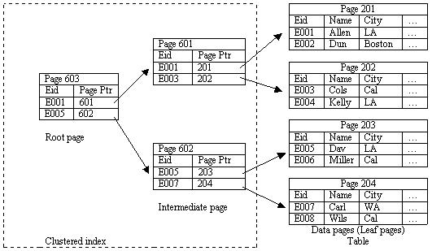
Identifying the Types of Indexes (Contd.)
Clustered index:
  It sorts and stores the data rows in the table based on their key values.
  The following figure displays a clustered index on the Employee table.
Notes:
CG Input: While teaching the students how to store and retrieve XML data, you need to demonstrate the examples given in the chapter. For the demonstration, you can use the data files present in the TIRM CD to create the required database objects or files.
Before showing the example, execute the CreateTable.SQL database script , present in the Chapter 5\Instep folder of the TIRM CD. Use CustomerDetails.xml for the XML snippet.

Slide 7
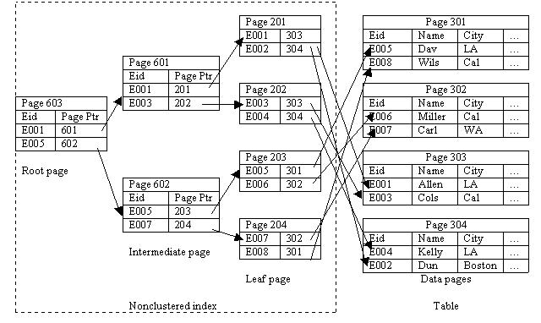
Identifying the Types of Indexes (Contd.)
Nonclustered index:
  The physical order of the rows is not the same as the index order.
  The following figure represents the working of a nonclustered index.
Notes:
CG Input: While teaching the students how to store and retrieve XML data, you need to demonstrate the examples given in the chapter. For the demonstration, you can use the data files present in the TIRM CD to create the required database objects or files.
Before showing the example, execute the CreateTable.SQL database script , present in the Chapter 5\Instep folder of the TIRM CD. Use CustomerDetails.xml for the XML snippet.

Slide 8
Creating Indexes
Index:
  Is created on the most frequently queried column in tables or views.
  Based on two or more columns is called a composite index.
  Can be created by using the CREATE INDEX statement.
Notes:
CG Input: While teaching the students how to store and retrieve XML data, you need to demonstrate the examples given in the chapter. For the demonstration, you can use the data files present in the TIRM CD to create the required database objects or files.
Before showing the example, execute the CreateTable.SQL database script , present in the Chapter 5\Instep folder of the TIRM CD. Use CustomerDetails.xml for the XML snippet.

Slide 9
Creating Indexes (Contd.)
  Syntax:
      CREATE [UNIQUE][CLUSTERED | NONCLUSTERED] INDEX index_name
      ON [{database_name.[schema_name]. | schema_name.}]
      {table_or_view_name}(column [ASC | DESC][,...n])
      [WITH(<relational_index_option>[,...n])]
      [ON {partition_scheme_name(column_name[,...n])
      | filegroup_name | DEFAULT}]
      <relation_index_option>::=
      {PAD_INDEX = {ON | OFF}
      | FILLFACTOR = fillfactor
      | ONLINE = {ON | OFF}
Notes:
CG Input: While teaching the students how to store and retrieve XML data, you need to demonstrate the examples given in the chapter. For the demonstration, you can use the data files present in the TIRM CD to create the required database objects or files.
Before showing the example, execute the CreateTable.SQL database script , present in the Chapter 5\Instep folder of the TIRM CD. Use CustomerDetails.xml for the XML snippet.

Slide 10
Creating Indexes (Contd.)
  You can create a clustered index on the EmployeeID attribute of the Employee table by using the following statement:
      CREATE CLUSTERED INDEX IX_EmployeeID
      ON Employee (EmployeeID)
      WITH FILLFACTOR = 10
  The following statement creates a nonclustered index on the ManagerID attribute of the Employee table:
      CREATE NONCLUSTERED INDEX IDX_Employee_ManagerID
      ON Employee (ManagerID)
Notes:
CG Input: While teaching the students how to store and retrieve XML data, you need to demonstrate the examples given in the chapter. For the demonstration, you can use the data files present in the TIRM CD to create the required database objects or files.
Before showing the example, execute the CreateTable.SQL database script , present in the Chapter 5\Instep folder of the TIRM CD. Use CustomerDetails.xml for the XML snippet.

Slide 11
Creating Indexes (Contd.)
  Consider the following guidelines while creating indexes on a table:
    Create clustered indexes on columns that have unique or not null values.
    Do not create an index that is not used frequently. You require time and resources to maintain indexes.
    Create a clustered index before creating a nonclustered index. A clustered index changes the order of rows. A nonclustered index would need to be rebuilt if it is built before a clustered index.
    Create nonclustered indexes on all columns that are frequently used in predicates and join conditions in queries.
Notes:
CG Input: While teaching the students how to store and retrieve XML data, you need to demonstrate the examples given in the chapter. For the demonstration, you can use the data files present in the TIRM CD to create the required database objects or files.
Before showing the example, execute the CreateTable.SQL database script , present in the Chapter 5\Instep folder of the TIRM CD. Use CustomerDetails.xml for the XML snippet.

Slide 12
Summary
In this session, you learned that:
  Indexes are created to enhance the performance of queries.
  There are two types of indexes, clustered and nonclustered.
  Indexes are created by using the CREATE INDEX statement.
  Clustered indexes should be built on an attribute whose values are unique and do not change often. Data is physically sorted in a clustered index.
  In a nonclustered index, the physical order of rows is not the same as that of the index order.
  A nonclustered index is the default index that is created with the CREATE INDEX statement.
Notes:
CG Input: While teaching the students how to store and retrieve XML data, you need to demonstrate the examples given in the chapter. For the demonstration, you can use the data files present in the TIRM CD to create the required database objects or files.
Before showing the example, execute the CreateTable.SQL database script , present in the Chapter 5\Instep folder of the TIRM CD. Use CustomerDetails.xml for the XML snippet.

